Slide 1
JAVA Spring Boot & MySQL using Hibernate
Alay Deliwala

Slide 2
About Spring Boot
Spring Boot is a suite of frameworks/technologies that are pre-configured to reduce boiler plate configuration. It is a small part of the Java Spring Framework
Provides the shortest way to have a RESTful web application up and running with smallest line of code/configuration.
Highly useful to get started with minimum effort and create stand-alone, production-grade applications.

Slide 3

About MySQL and MAVEN
MySQL is an Open-source Relational Database Management System
It will be used to store the information that is being queried by the end user
Maven is a build automation tool used primarily for Java projects.
It addresses two aspects of building software: How software is built, and the dependencies needed.
Information required by maven is stored in a pom.xml file

Slide 4
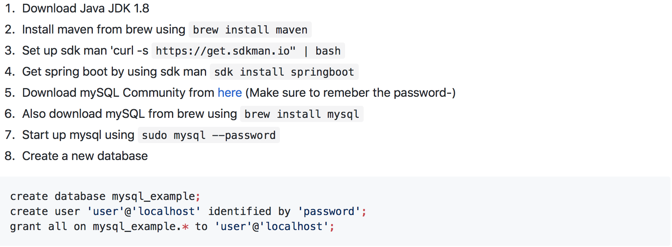
Set-up

Slide 5
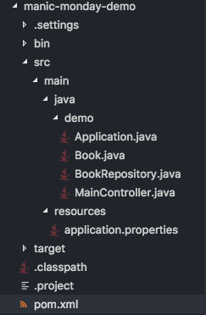
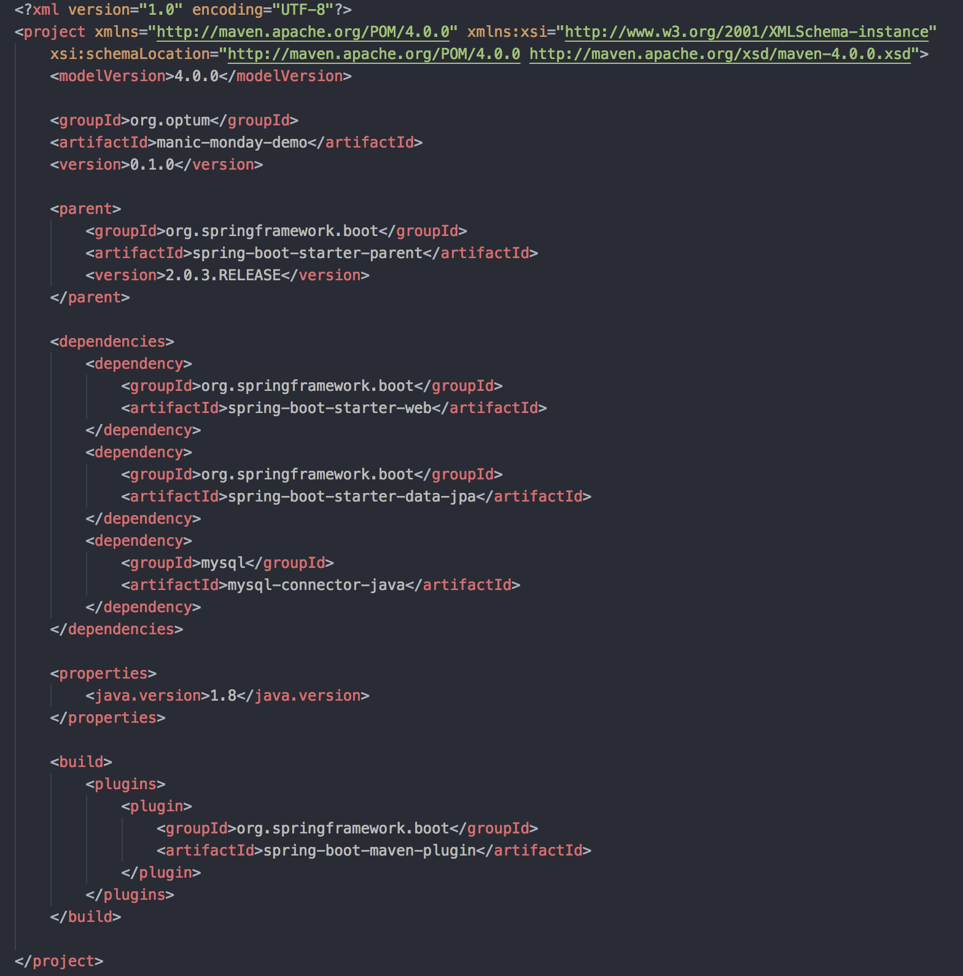
Breaking Down the POM.XML
POM (Project Object Model)
Group name
Name of the project
Version
Dependencies required for this project
MySQL connector
Basic Spring Boot dependencies
Build Settings

Slide 6
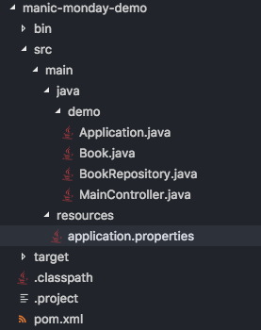
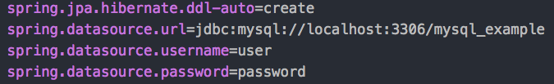
Create the application.properties file
To connect to the MySQL local database you need to create an application.properties file
In this file you will specify
Name of the database
Username
Password
Port

Slide 7
Trade in Schemas For Hibernate
MySQL uses a schema.sql file to determine the structure of the tables and relationships in the database.
By using Hibernate and Spring Boot we can eliminate the need for the schema.sql and replace it with annotations.
Hibernate ORM is an object-relational mapping tool for Java. It provides a framework for mapping an object-oriented domain model to a relational database

Slide 8
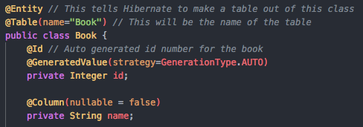
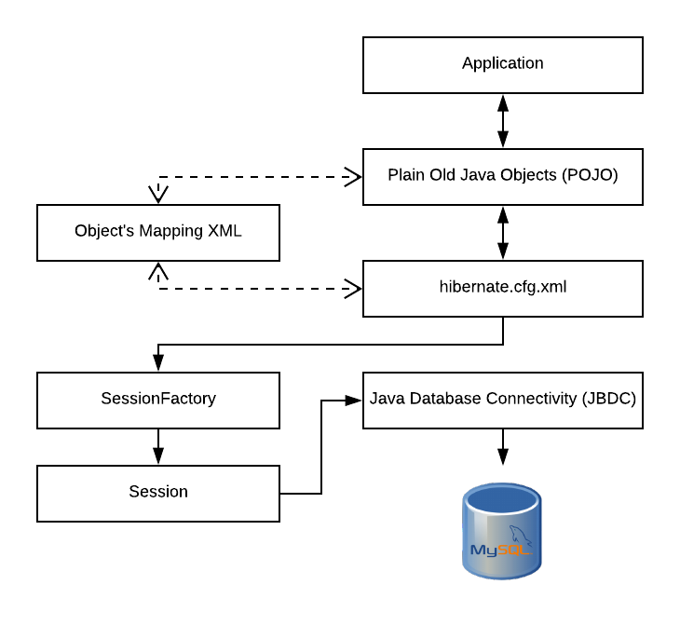
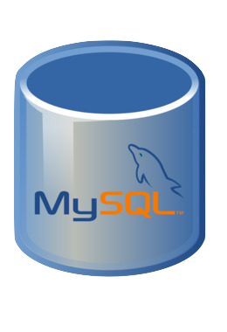
Hibernate
Hibernate, using annotations, will make a table
and make the global variables columns in the table
book
book_id INT(11)
name VARCHAR(225)
This is how the table will look in MySQL

Slide 9
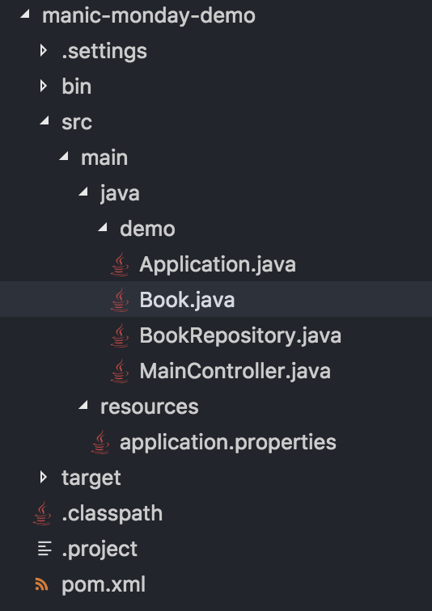
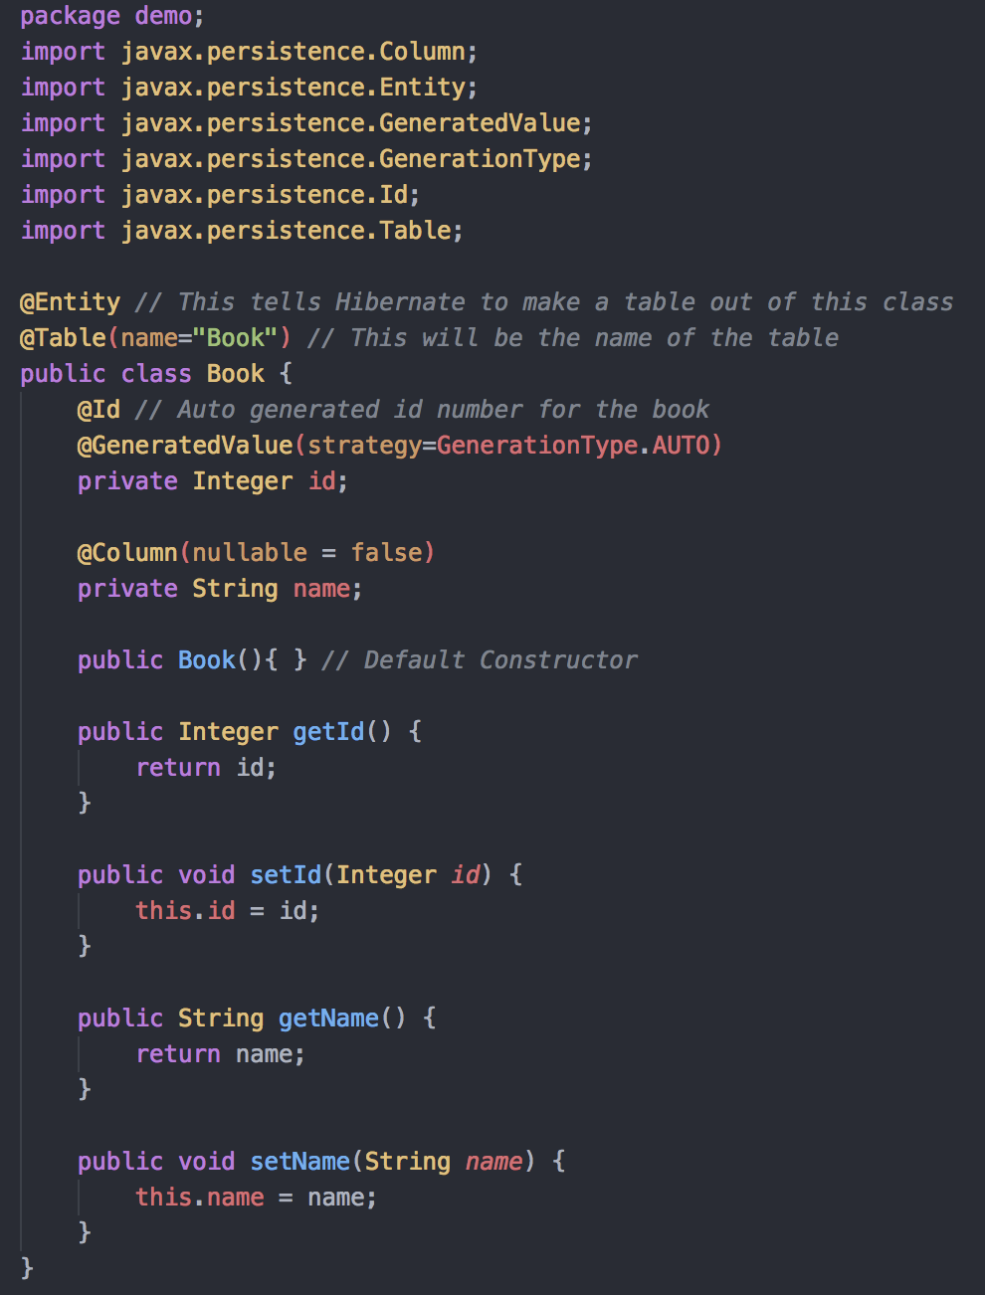
Creating a Book POjo
These fields will be turned into columns in the book table
These are getters and setters to access object data in controller classes

Slide 10
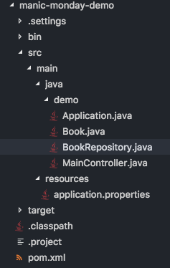
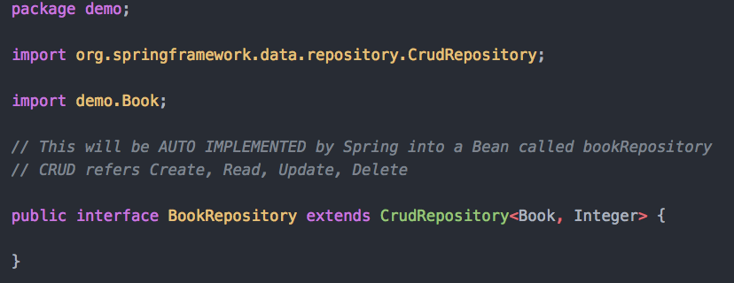
Creating a Book CRUDREPOSITORY
Type of object that will be stored in the repository
Common CrudRepository Methods
Insert
save(S entity)
Look Up
findById(ID id)
findAll()
Delete
delete(T entity)
deleteById(ID id)
BookRepository.java
The CrudRepository interface allows you to create, read, update and delete records without having to define your own methods.
This will be automatically implemented by Spring in a bean with the same name with changing case
BookRepository -> bookRepository

Slide 11
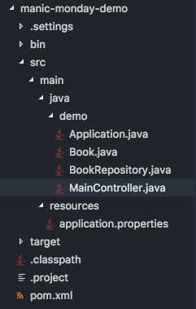
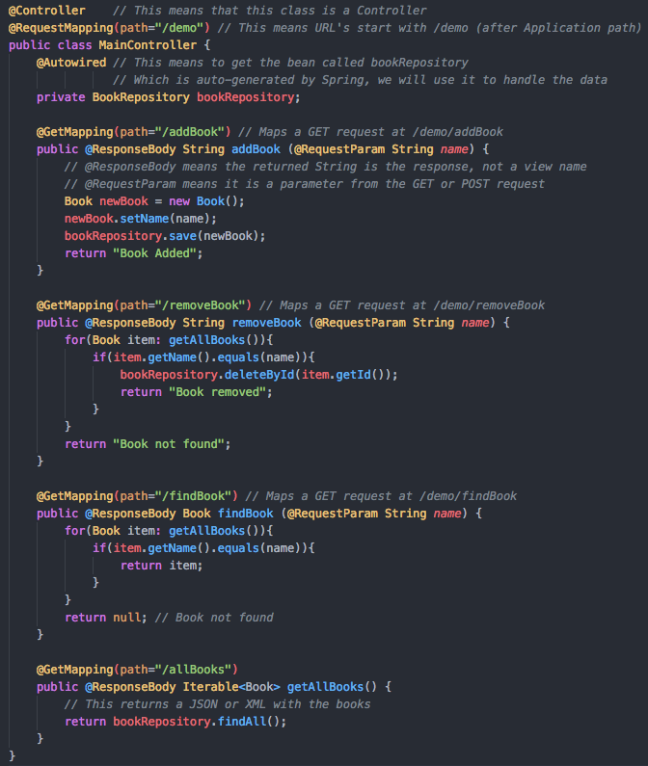
Main Controller and Routing
Shows the initial controller routing
Initializes the book repository
Calling this route with the correct parameters will add a book to the database
MainController.java
The class where all the routing is done
Can’t map 2 requests to the same URL unless they are a GET and a POST
Responses are returned in JSON
Example HTTP Requests
localhost:8080/demo/addBook?name=1984
Adds the book “1984” to the database
localhost:8080/demo/all
Returns all the books in the database

Slide 12
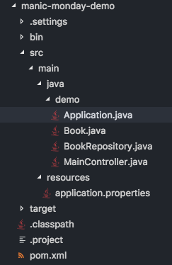
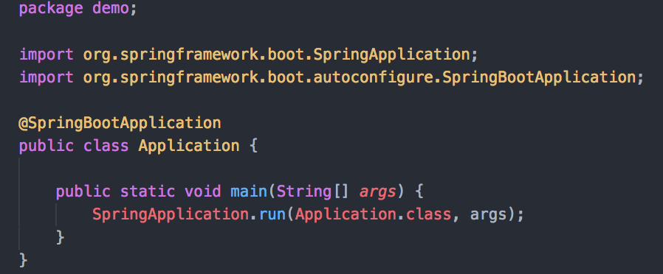
Making the Application Executable
Application.java
Spring-Boot packages everything in a single, executable JAR file, driven by a good old Java main() method.
The packaging is done by Maven
Spring embeds the Tomcat servlet container as the HTTP runtime, instead of deploying to an external instance.
Running the application
mvn clean install
Downloads the dependencies
mvn spring-boot:run
Starts the server

Slide 13
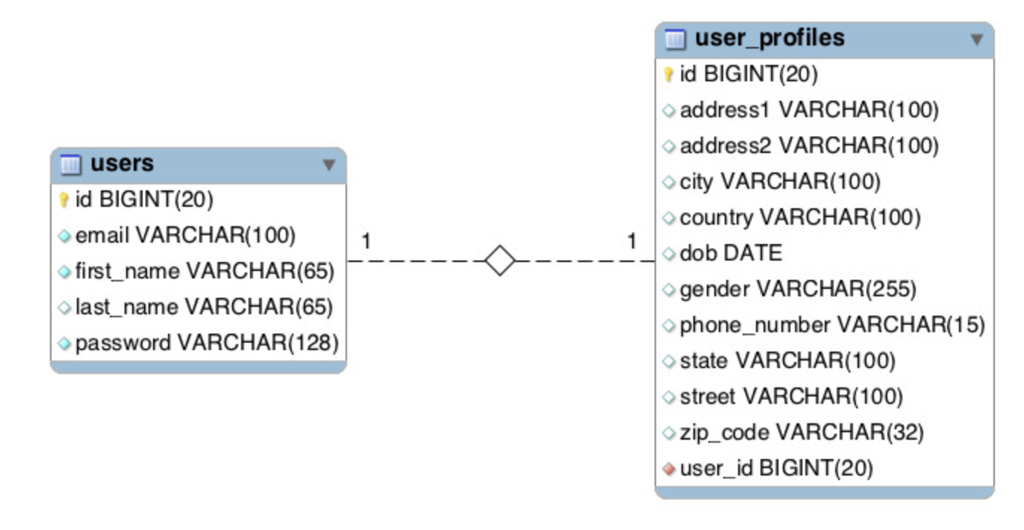
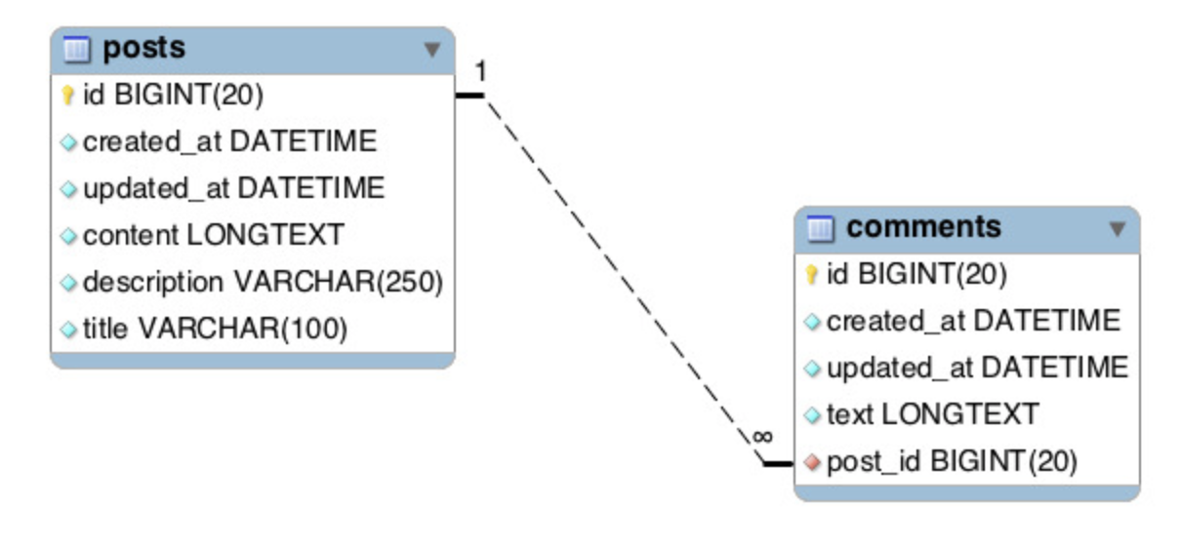
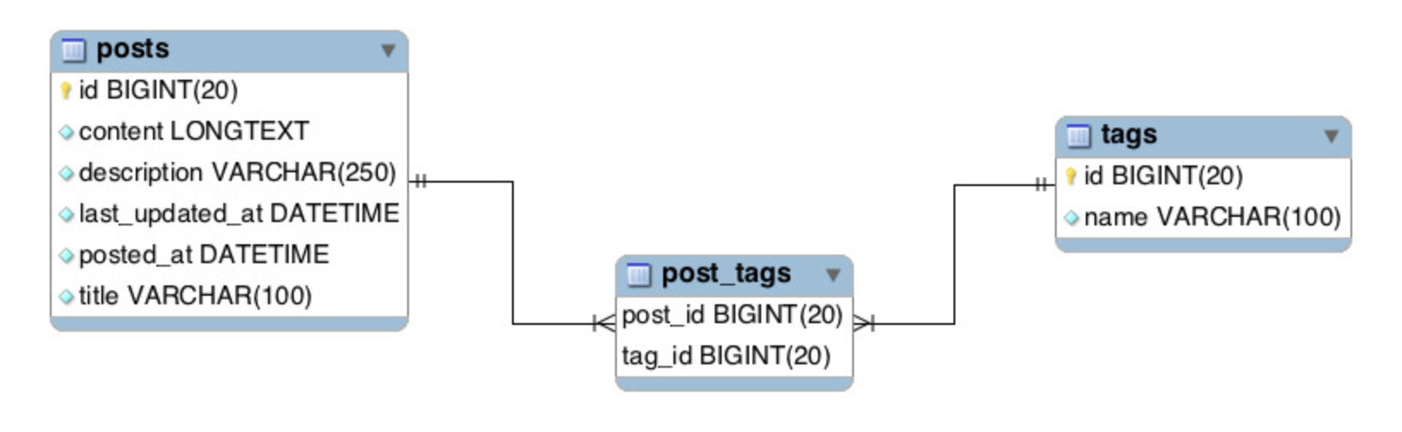
Relationships
One to One Relationship
Every user has a unique user profile
@OneToOne
One to Many Relationship
Every post can have many comments
@OneToMany & @ManyToOne
Many to Many Relationship
A post can have many tags and a tag can have multiple posts
@ManyToMany

Slide 14
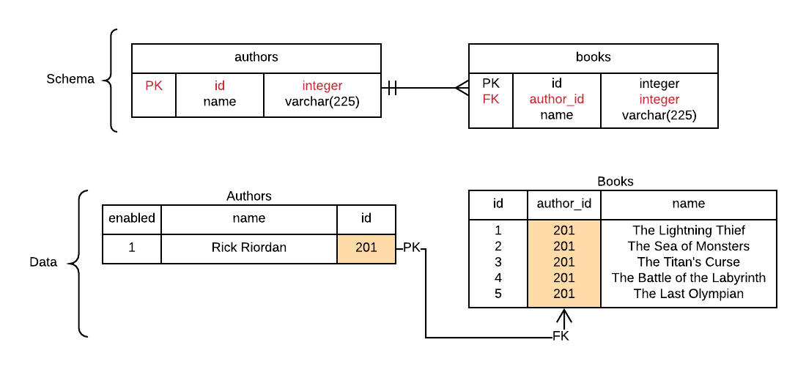
Demo Example
Example: An Author has many Books
Mapping: One To Many Relationship
Every book will have a foreign key
referencing the primary key of the author
PK: Primary Key FK: Foreign Key

Slide 15
Why USE Spring BooT?
Spring Boot makes it easy to create production-grade applications and services with minimal configuration.
Easy way to utilize the tools provided by the Spring Framework
State of the art Web MVC framework for building web applications
Easy to use but has powerful database transaction management capabilities

Slide 16
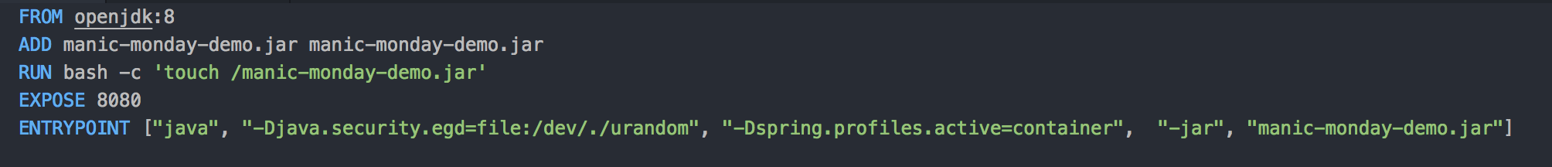
Utilizing Docker & OpenShift
Docker
Requires very little configuration
Add the Docker dependencies to the pom.xml file
Add a Dockerfile
Build your project (mvn clean install package docker:build –X)
Tag your image (docker tag MMDemo alaydeliwala/manic-monday-demo)
Push to Docker (docker push alaydeliwala/MMDemo)
Openshift
1. Create a MySQL pod
oc new-app -e MYSQL_DATABASE=mysql_example -e MYSQL_ROOT_PASSWORD=password --docker-image="mysql:5”
2. Create a new pod using the Docker file
oc new-app --docker-image=alaydeliwala/MMDemo
3. Connect MMDemo pod and mySQL Pod

Slide 17
Resources & Links
Demo
Entire demo is available on my GitHub
https://github.com/alaydeliwala/manic-monday-demo
MySQL Workbench
Easy way to visualize the MySQL database
https://www.mysql.com/products/workbench/
Links
Getting started with spring-boot
https://docs.spring.io/spring-boot/docs/current/reference/html/getting-started-first-application.html
Using MySQL
https://spring.io/guides/gs/accessing-data-mysql/

